Slide 1
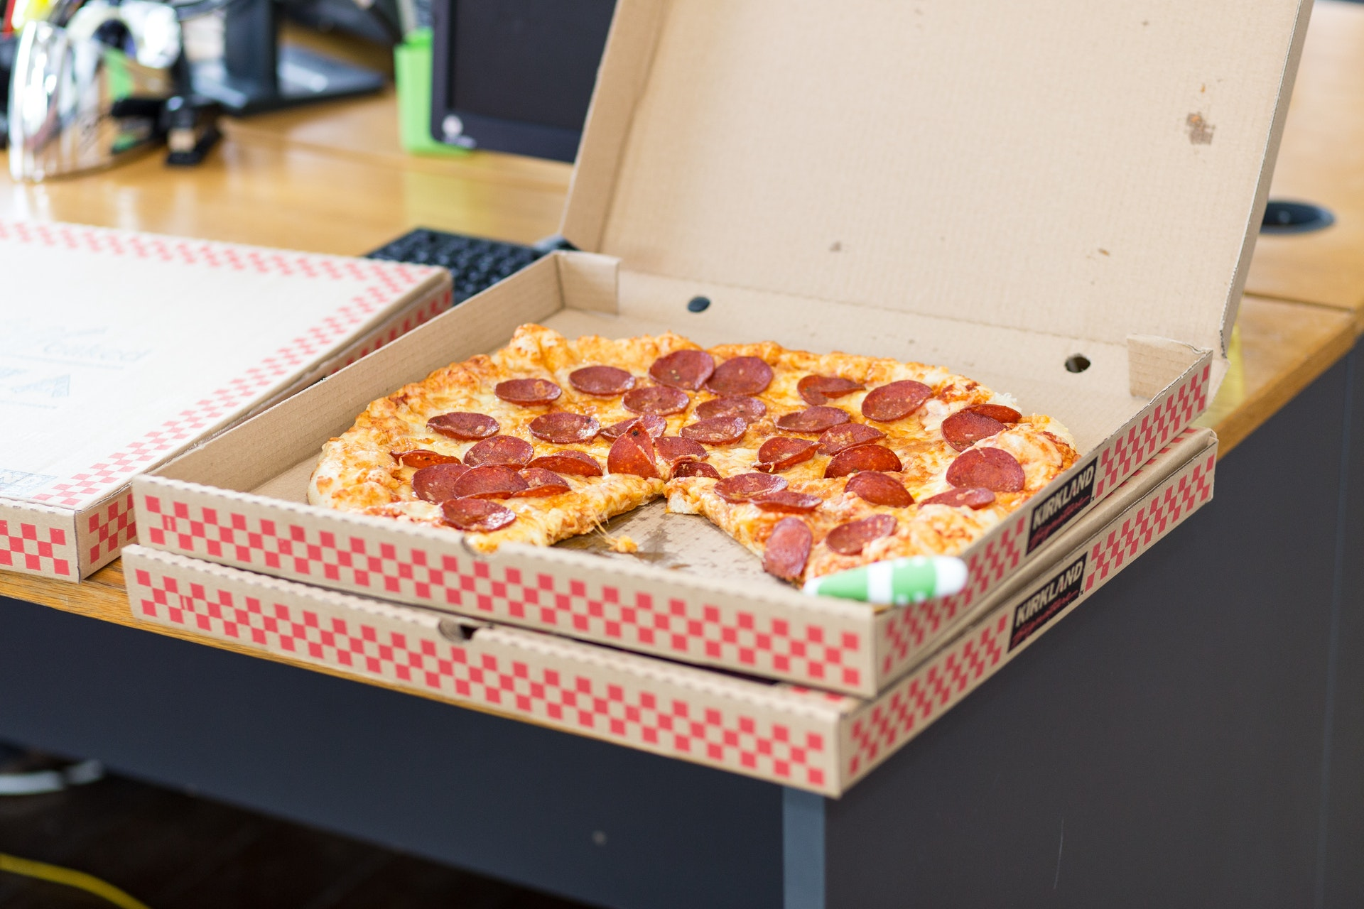
Pizza Comes in a Box
Separation
Boxes tell us where each pizza starts and ends
We Don’t Eat the Box
It’s disgusting.
We Eat Pizza
But without the box, the pizzas would be disgusting.
Details
Boxes tell us about the pizza

Slide 2
Protocols are like [Pizza] Boxes
Version Info
What is this?
<!DOCTYPE html>
<html>
<head>
<meta charset='utf-8'>
<meta http-equiv='X-UA-Compatible' content='IE=edge'>
<title>Page Title</title>
<meta name='viewport' content='width=device-width, initial-scale=1'>
</head>
<body>
This is the part you can see.
</body>
</html>
Meta-Data
Information about the content.
Start
Where do we begin?
End
Body
Crucial! Where do we stop?
The part the user actually “consumes.”
http://www.evolutionoftheweb.com/

Slide 3
HTTP Protocol
HTTP Request
Request Line <METHOD> <URL> <VERSION> GET /index.html HTTP/1.1
Some Methods (verbs): Traditional “browser” methods: GET POST (Request has a body) HEAD (no body) API-Related (growing in popularity) PUT DELETE PATCH HTTP Versions: 1.0 – Non-Persistent 1.1 – Persistent 2.0 – Major Update
Header Lines <HEADER NAME>: <VALUE> Host: www.example.com
Response Line <VERSION> <STATUS > <PHRASE> HTTP/1.1 200 OK
Common Status Codes: 2xxx: Success 200 – OK 3xx: Redirect 301 – Moved Permanently 4xx: Client Errors 400 – Bad Request (Bad API Call) 403 – Unauthorized (Bad API Call) 404 – Not Found 5xx: Server Errors 500 – Internal Server Error
Request Line
Header Line
…
Header Line
Blank Line
[Optional] Body
HTTP Response
Response Line
Header Line
…
Header Line
Blank Line
[Optional] Body

Slide 4
HTTP Protocol—Browser Example
Server
Server Opens a Socket
Browser
Server Waits for a Connection
HTTP Request
HTTP Response
Client Parses Response
Client requests additional resources based on the body of the response. These could be images, .css, or .js files.
Server receives multiple requests almost simultaneously. This is where threading comes into play.
Client either requests additional resources or has enough to display a page.

Slide 5

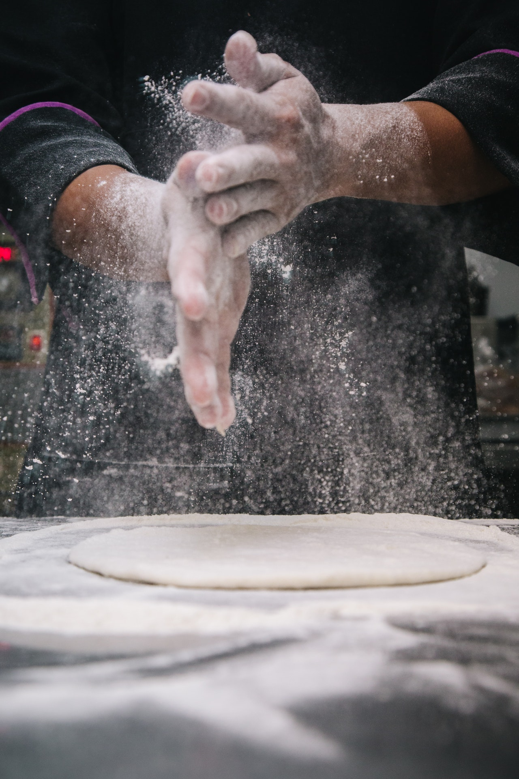
HTTP Protocol
HTTP 1.0
HTTP 1.1
Non-persistent.
You can only make one request at a time.
Most notably, maintains a persistent connection.
Hello, I’d like to order a cheese pizza.
Goodbye.
Hello, I’d like to order a cheese pizza,
A pepperoni pizza,
and a supreme pizza.
Goodbye.
Hello, I’d like to order a pepperoni pizza.
Goodbye.
Hello, I’d like to order a supreme pizza.
Goodbye.
Photos courtesy Pexels.com and are subject to the pexels license, https://www.pexels.com/license/

